Slide 1

Hosting and cloud Research and info links

Slide 2
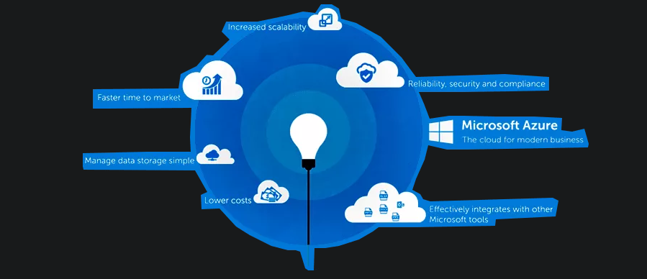
Azure for cloud and webhosting
https://www.epcgroup.net/azure-web-hosting-pricing-and-service-plans/

Slide 3
Why use azure for cloud computing and hosting
I know how to use azure
Its easily scalable
Very good for cloud stuff
Good for bigger business
Can create web hosting through some extra steps

Slide 4
Why not use azure
https://azure.microsoft.com/en-us/pricing/calculator/
A pricing calculator
May be out of scope
Can be complicated if you don’t know what you are doing
Can be expensive
Less for hosting more cloud computing side
Great security options built in
Can be used for an on site way to enter details and keep track of users
https://www.atmosera.com/blog/5-reasons-to-host-your-website-in-microsoft-azure/

Slide 5

Moving away from azure
I believe it is not worth it right now for the scale and scope of the business
But! If Davey continues to grow it may be very beneficial down the line
Dreamhost we will be looking at now

Slide 6
Why use dreamhost
Its what it primarily for
Better than azure in the aspect of hosting
Better priced
One of the best according to the internet
Can still host domains registered by other websites
Great support service apparently
Wordpress recommends it
https://help.dreamhost.com/hc/en-us/articles/215560437-What-types-of-hosting-plans-are-available-

Slide 7
Why not use dreamhost
There may be better priced options on the market
Lacks the overall functionality of azure
I know less about dreamhost

Slide 8
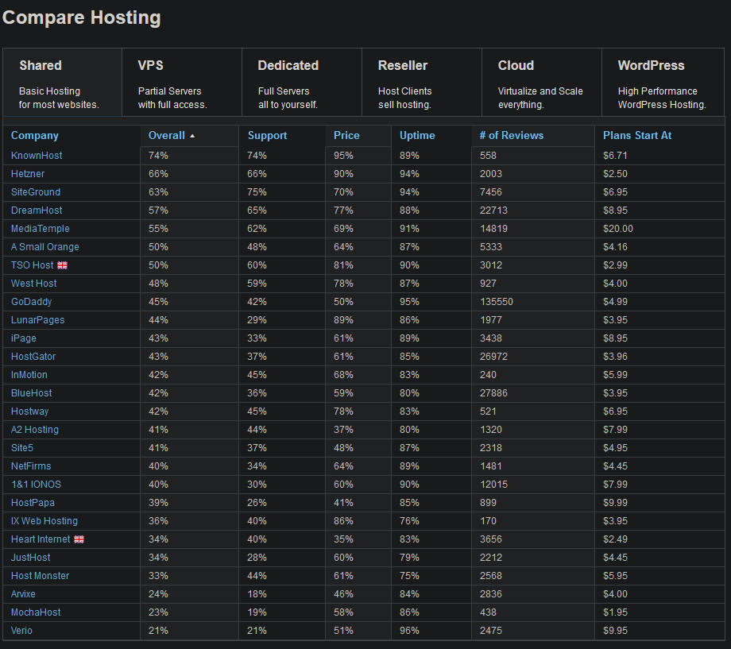
A website showing usage
https://reviewsignal.com/webhosting/compare
Dreamhost among the most popular
And has the best rating according to the next slide

Slide 9

A chart I found of pricing and benifits
Godaddy not used in business as much apparently
https://docs.google.com/spreadsheets/d/e/2PACX-1vQPTLkEUU44Yy87upOMUyq12KpQ6f7BqRrg5igyuA2mZK7xNN-ZH_5TYHicIn0jWdLVCS26bEX2nLK2/pubhtml

Slide 10
Other queries
Can use something like wordpress/squarespace that can assist in making the site for you
Any other options on the lists
Can use github hosting for showing in class and at meetings
Godaddy is also a highly recommended choice and seems like cannot go wrong between the two
Discuss with web dev about what they think and research if they have a preference

Slide 11

Thanks (:
By Bradley Dunlop

